Slide 1

Introduction to the Internet of Things(COI29226)
ASSESSMENT 3 (PRESENTATION)
(TERM-2 2022)
Submitted To:
Unit Coordinator, Tutor, Lecturer : Jahan Hassan
1

Slide 2
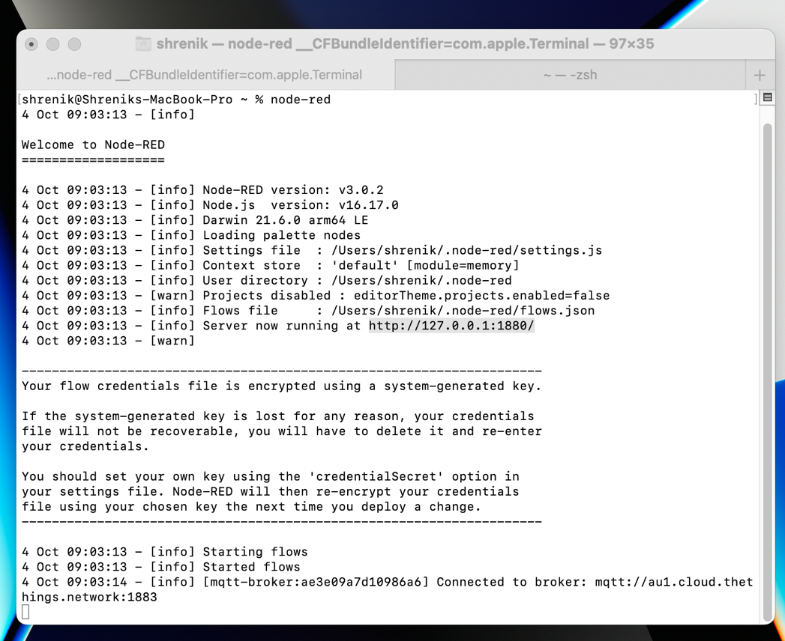
Steps to Configure the project applications:
Step 1: Installed the Node-red, InfluxDB database, and Grafana dashboard first.
Step 2: Start the node-red server using command node-red and open the browser and type http://127.0.0.1:1800/.

Slide 3
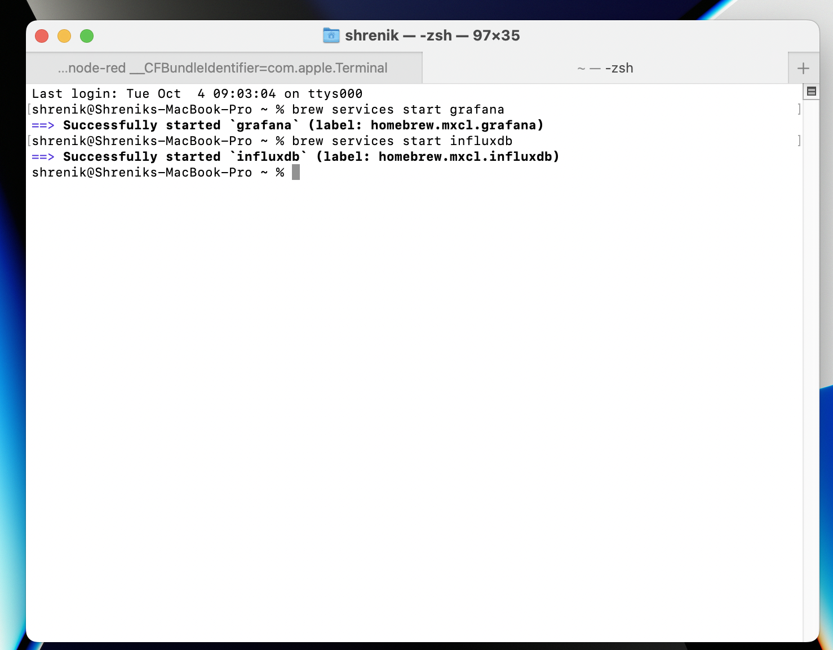
Steps to Configure the project applications:
Step 3: Start the InfluxDB and Grafana Server respectively by typing the brew services start grafana, brew services start influxdb:

Slide 4
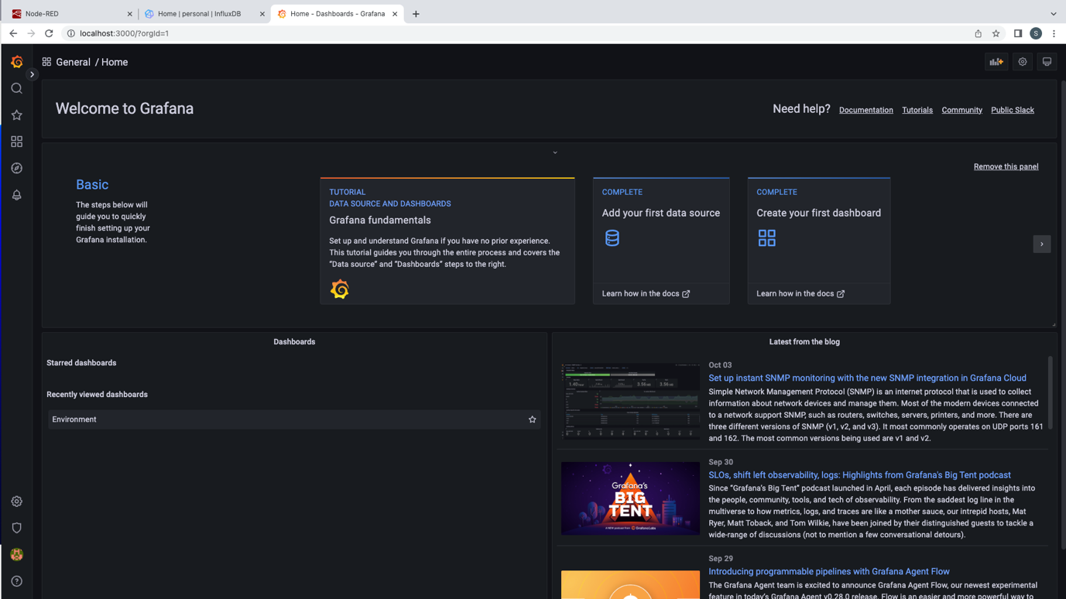
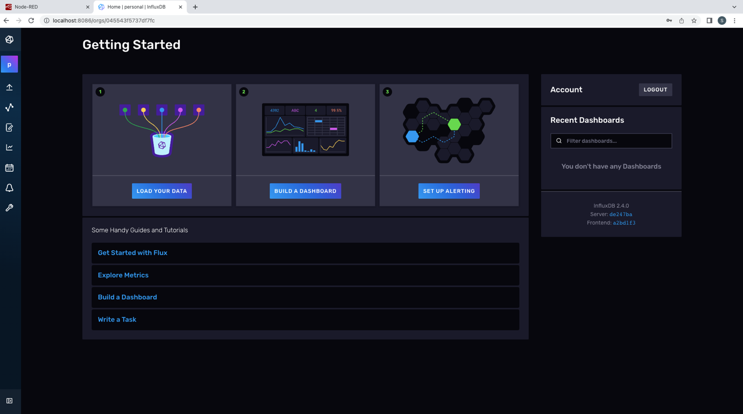
Steps to Configure the project applications:
Step 4: Run the localhost server of Grafana and Influxdb by typing the following commands in the screenshot below:

Slide 5
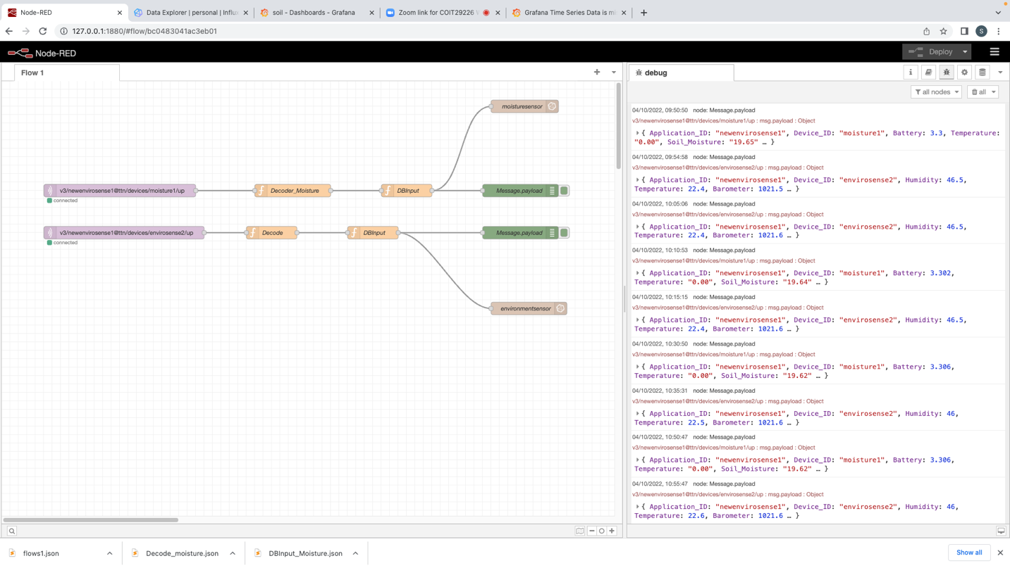
Steps to Configure the project applications:
Step 5: Configure the two give sensors moisture and environment respectively as an MQTT node from placed at CQU campus or at the field and we will start receiving the data from the screenshot it can be seen that the data coming from the sensors are getting decoded and feed to the DB input and from DB input the connection are going to DB output of InfluxDB and debug node which shown the data in the node-red debug console.

Slide 6
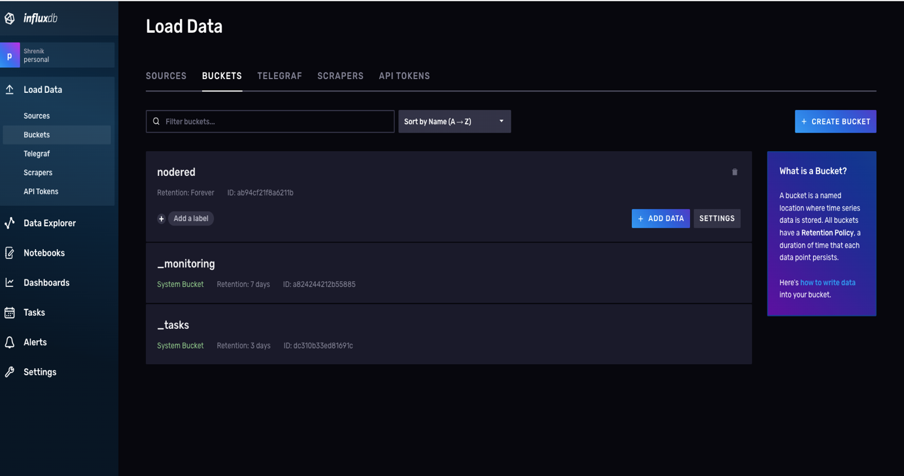
Steps to Configure the project applications:
Step 6: After receiving the data we will configure the bucket named node-red into the Influx DB to receive and store the data coming from the node-red MQTT nodes.

Slide 7
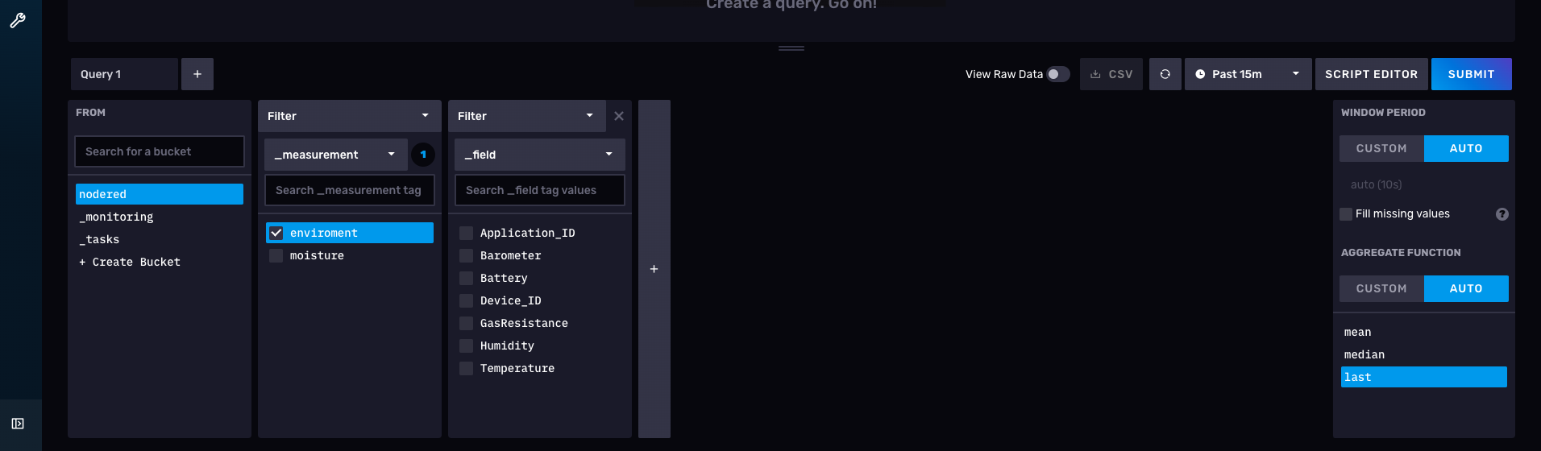
Steps to Configure the project applications:
Step 7: After that we can see the two measured of the sensors data with the data elements. These steps are same for the moisture and environment sensors:

Slide 8
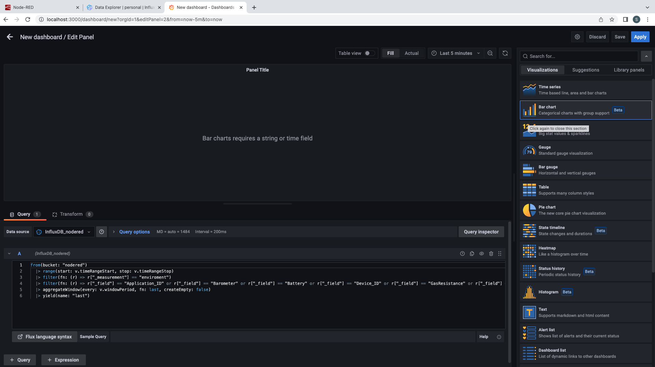
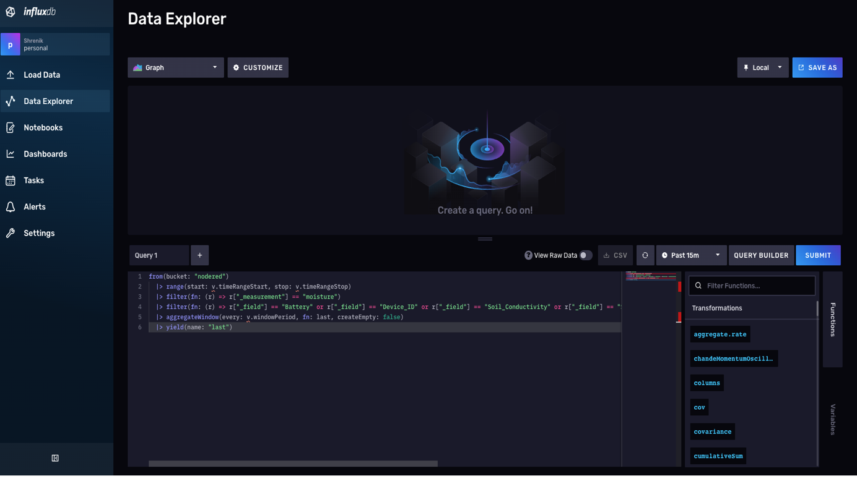
Steps to Configure the project applications:
Step 8: After that to query the data we will use the script editor by selecting the time mean, median or last here I have selected last, these steps are same for the moisture and environment sensors:
Step:9 Copy the selected query go to the Grafana dashboard and paste into the query by clicking on the Dashboard and add new panels:

Slide 9
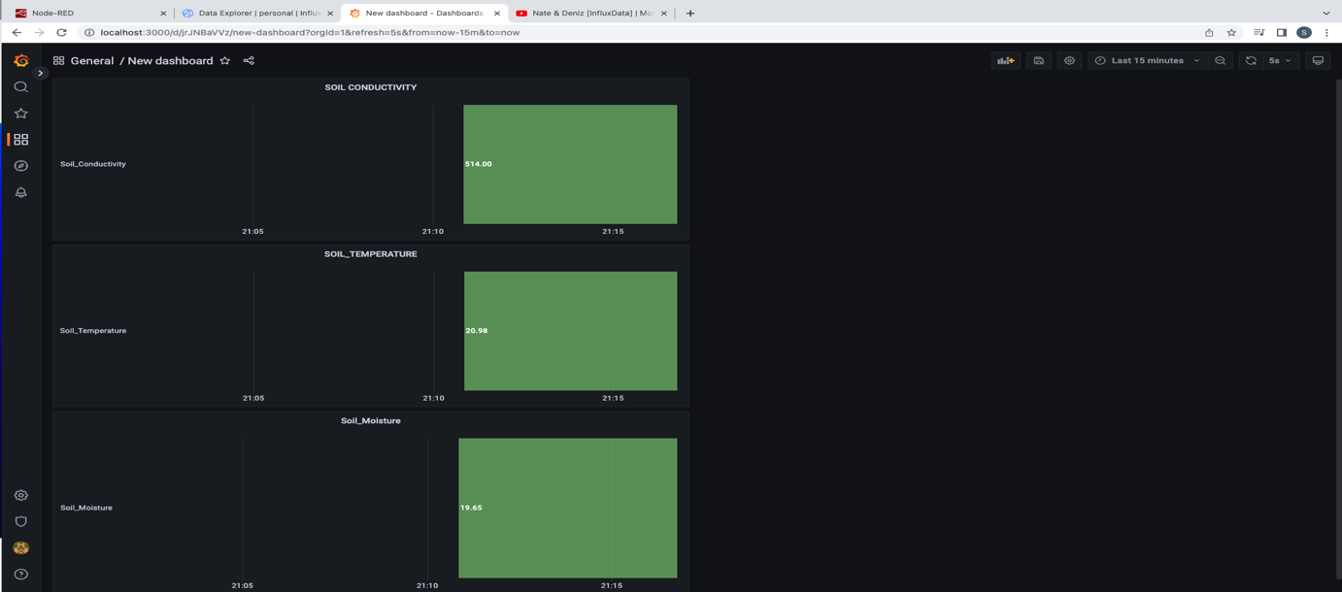
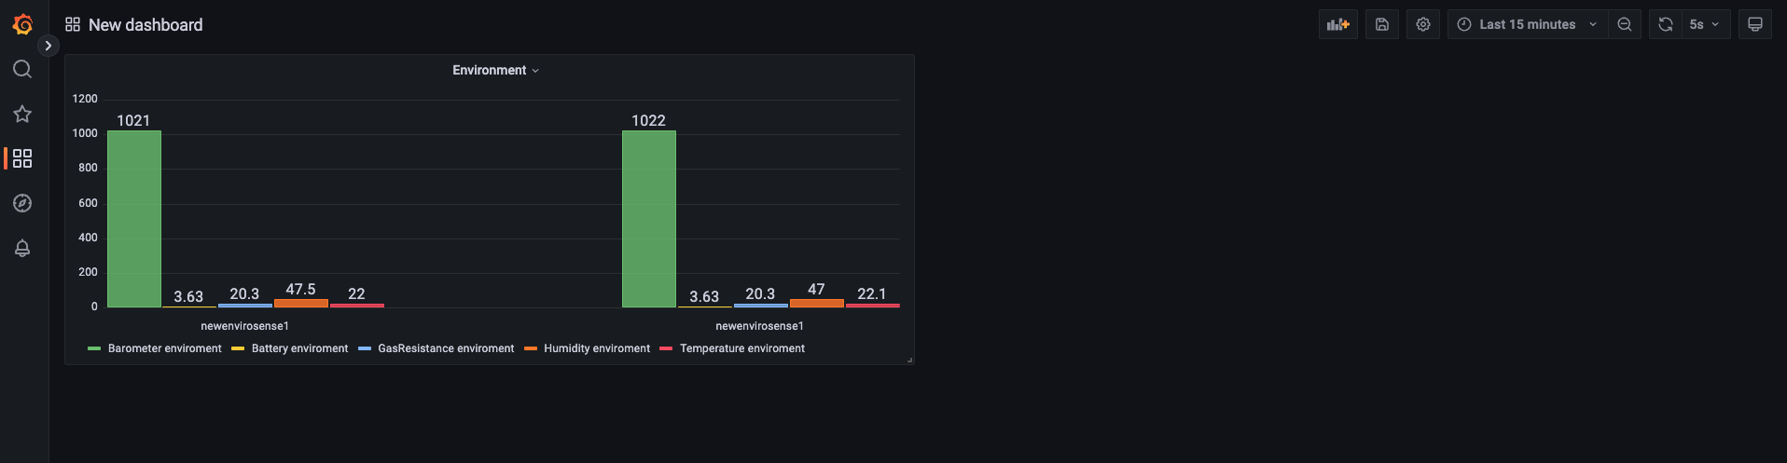
Steps to Configure the project applications:
Step 10: After Seeing clicking on apply button the charts/graphs can be seen for the sensors data with the different time intervals like 5m, 15m, 1h, etc. and different types of graphical visualizations:

Slide 10



10
This Photo by Unknown Author is licensed under CC BY-NC

